Slide 1
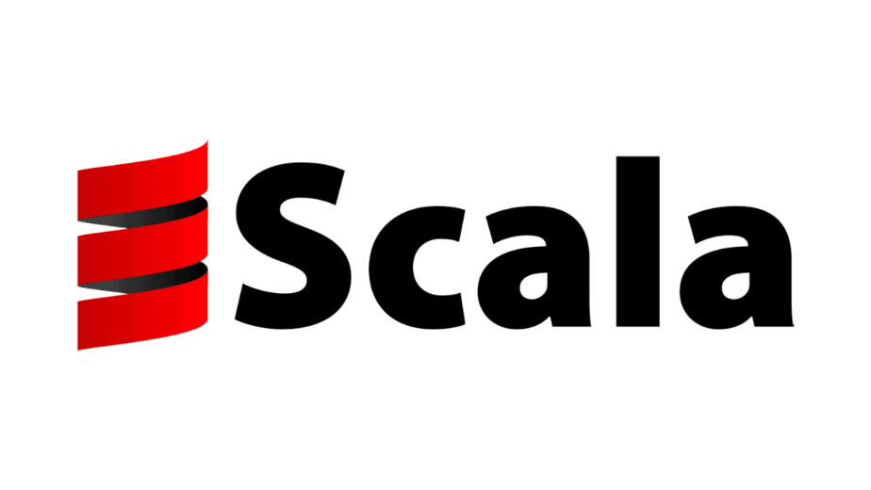
Jugal Gajjar Saptorshee Nag Kaustik Ranaware Saurabh S R Michael Womack

Slide 2
Introduction
Scala is a high-level, multi-paradigm programming language that combines object oriented programming and functional programming.
Popular use cases for scala are big data, distributed computing, micro services, ad-serving, communication platforms, real-time information processing, and so ons
Scala was designed to be high scalable making it great for running small scripts or large distributed systems
It runs on the Java Virtual Machine (JVM), making it compatible with existing Java Libraries
Contributors:
Scala Center, Lightbend, and VritusLab
Notes:
Michael

Slide 3
Names, Binding, and Scopes
Scala allows you to use operator-like symbols as identifiers, which is not common in many other languages.
Example: +, :, ::, and =>
Scala allows defining methods and variables using operator-like symbols, which makes it easier to define custom operators. For instance, you can define a method as
def + (that: MyClass): MyClass = {...}
A unique feature of Scala is the companion object. When you define a class and an object with the same name, the object is a "companion" to the class. They share the same name and scope but can access each other's private members.

Slide 4
Names, Binding, and Scopes contd..
Example of companion class:
class MyClass {
private val secret = "Hidden"
}
object MyClass {
def reveal = (new MyClass).secret // Can access 'secret' because it shares the same scope
}

Slide 5
Data Types
Scala’s data types are versatile, combining the rigor of static typing with the expressiveness of functional programming.
In Scala, everything is an object — even primitive types like Int, Double, and Boolean.
Scala has special bottom types, Nothing and Null.
def fail(message: String): Nothing = throw new Exception(message)
Scala provides a powerful way to handle the absence of values via the Option type. This is a unique and functional alternative to null.

Slide 6
Data Types contd…
Scala has tuples, They are immutable and can store multiple items of potentially different types without needing to create a specific class or case class. A tuple can hold from 2 to 22 elements, each can be different data type.
val tuple = (1, "Scala", 3.14) // Tuple of Int, String, and Double
Scala introduces case classes, which are a special type of class optimized for immutability and pattern matching.
case class Person(name: String, age: Int)
val person = Person("John", 30)
person.name // Accessing fields

Slide 7
Expressions and Assignment Statements
Expressions
Everything is an Expression: In Scala, almost everything (e.g., if statements, match cases, loops) is treated as an expression, meaning they return a value.
Example: val x = if (a > b) a else b
The above is an expression where if-else returns the larger of a or b.
Functional Nature: Scala encourages a functional programming style. Since expressions return values, you can often avoid using mutable state.
Type Inference: Scala's compiler automatically infers the type of expressions, reducing the need for explicit type annotations.
Example: val y = 10 // The type of y is referred to be Int.

Slide 8
Expressions and Assignment Statements contd….
Assignment Statements:
Immutable by Default: Variables in Scala are immutable by default, declared using val. Once assigned, their value cannot change.
Example: val z = 42
z = 50 // This will result in a compilation error.
Mutable Variables: If you need to reassign a variable, use var. However, this is generally discouraged in favor of immutability.
Example: var counter = 0
counter = counter + 1 // Reassigning a new value to the mutable variable.
Expressions vs. Statements: Scala emphasizes expressions over statements (which do not return values). Even loops (e.g., for, while) can be considered expressions, although they are usually avoided in functional programming in favor of more abstract constructs like map, flatMap, etc.

Slide 9
Scala and Object Oriented Programming
Due to Scala running on top of the Java Virtual Machine, Scala’s object orient programming supports the following features:
Classes
Objects
Inheritance
Traits
Encapsulation
Polymorphism
Unlike Java, classes aren’t required allowing scala programs to integrate functional programming languages into their applications seamlessly without disrupting the project structure.

Slide 10
Concurrency
Concurrency is a key aspect of the language, achievable via it’s several tools and abstractions:
Java Threads: Scala runs on the Java virtual machine meaning it inherits all of Java’s threading libraries (i.e Execution Context)
Futures and Promises: A part of Scala’s standard library; Future represents a value that may not be available yet, allowing for non-blocking operations. “Promise” can be used to complete a future what the value is known
Parallel Collections: A series of included operations; map, filter, and reduce. Automatically parallelizing code written via threads.
Akka Streams: Scala’s native reactive programming libraries that allow developers to work with multiple streams of asynchronous data at a time
Scala has high levels of abstraction that simplify concurrency for the developer, yet it is not immune to race conditions. Thus using immutable data types is encouraged.
Notes:
Michael

Slide 11
Event Handling
Event handling in Scala is commonly achieved through its actor-based model and reactive programming frameworks like Akka. By utilizing actors for asynchronous message passing, Scala efficiently handles events in a concurrent, non-blocking way.
Reactive Programming: Scala offers good support for reactive programming, making it suitable for handling asynchronous events.
Akka Framework: One of the most common frameworks for event-driven programming in Scala is Akka. It provides an actor-based model to handle concurrency and event handling in a scalable and resilient way.
Scala Swing (for GUI event handling): If you are working with GUIs, Scala provides the Scala Swing library, where you can handle UI events like button clicks, window resizing, etc.

Slide 12
Event Handling Contd….
Actor Model: Actors are objects that handle communication asynchronously by exchanging messages. Each actor has its own state and behavior and interacts with other actors via message passing.
Example:
import akka.actor._
class MyActor extends Actor {
def receive = {
case "Hello" => println("Hello back!")
case _ => println("Unknown message")
}
}
val system = ActorSystem("MySystem")
val myActor = system.actorOf(Props[MyActor], name = "myActor")
myActor ! "Hello"
Here, the actor MyActor reacts to the message "Hello" by printing a response.

Slide 13
Exception Handling
Basic Exception Handling: Use try, catch, and finally
try: The code that may throw an exception is placed inside the try block. catch: You can have multiple case statements to handle different types of exceptions. finally: This block will always execute, regardless of whether an exception was thrown or caught.
try { // Code that might throw an exception } catch { case e: ExceptionType1 => // Handle ExceptionType1 case e: ExceptionType2 => // Handle ExceptionType2 } finally { // Code that always runs (optional) }

Slide 14
Exception Handling
Using Try: The Try type is a more functional way to handle exceptions. It can be either a Success or a Failure, making it easier to work with error handling without using exceptions directly. import scala.util.{Try, Success, Failure} val result: Try[ReturnType] = Try { // Code that might throw an exception } result match { case Success(value) => // Handle the success case Failure(exception) => // Handle the failure case Eg. val result: Try[Int] = Try(10 / 2) // Success(5) val result2: Try[Int] = Try(10 / 0) // Failure(ArithmeticException) }
Throwing Exceptions(throw): You can throw exceptions explicitly using the throw keyword, allowing for custom error handling.

Slide 15
Functional programming in Scala
Functional Programming focus on What to do instead of How to do it, similar to the declarative style.
Scala along with Object-Oriented also supports Functional Programming.
Functional programming in Scala focuses on :
Pure functions
Immutability
Higher-order functions
First-Class Functions
Function Composition

Slide 16
Pure Function vs Impure Function
Pure Function : Why pure? def add(a: Int, b: Int): Int = a + b No side effects. println(add(2, 3)) // Output: 5 Only depends on a and b. println(add(2, 3)) // Output: 5 Gives the same O/P for the same I/P.
Impure Function : Why Impure? var result = 0 // External mutable state The function modifies the result def impureAdd(a: Int, b: Int): Int = { variable every time it is called, leaving a result = a + b // side effect. result } println(impureAdd(2, 3)) // Output: 5 println(impureAdd(2, 6)) // Output: 8 println(result) // Output: 8 (State has changed)

Slide 17
Immutability
Immutability in Scala
// Immutable variable using val val numbers = List(1, 2, 3, 4, 5) // Trying to modify it will result in a compilation error numbers = List(6, 7, 8) // Error: reassignment to val.
Scala provides several built-in immutable collections, such as List, Set, Map and Vector.

Slide 18
Higher Order Function
Higher Order Function in Scala:
// Higher-order function that takes a function as an argument def applyFunction(f: Int => Int, value: Int): Int = f(value) // Lambda function to square a number val square: Int => Int = x => x * x println(applyFunction(square, 5)) // Output: 25
A higher-order function is a function that takes another function as an argument or returns a function as a result. In this case, applyFunction is a higher-order function because it accepts another function f of type Int => Int.

Slide 19
First-Class Functions
Functions are treated as First-Class Citizens 1. Passed as argument 2. Assigned to variables
def Funct(f: Int => Int, value: Int): Int = f(value) val add: (Int, Int) => Int = (a, b) => a + b val square: Int => Int = x => x * x val result = add(3, 5) // result is 8 val squaredVal = Funct(square, 4)
3. Returned from other function
def adder(addedValue: Int): Int => Int = { (x: Int) => x + addedValue } val addThree: Int => Int = adder(3) val resultAddThree = addThree(5)

Slide 20
Questions?

Slide 21
Our Project - Big Data Processing Pipeline

Slide 22
Project Objective
To build an end-to-end big data processing pipeline using Scala, capable of efficiently ingesting, storing, processing, and analyzing large datasets to generate actionable insights.
Enable real-time data processing for fast decision-making, and ensure scalability and fault-tolerance for handling large-scale data.
Notes:
-> The main objective of this project is to build a big data processing pipeline that can handle massive amounts of data efficiently and in real time. Our goal is to ingest data from various sources, store it in a distributed manner, process it using scalable tools like Apache Spark, and extract valuable insights.
-> In a nutshell, we're building a system that turns raw data into useful information, quickly and reliably.

Slide 23
Constraints
Data Volume
Data Consistency
Latency
Scalability
Resource Management
Notes:
-> The first challenge is the volume of data—we're talking about handling 100s of gigabytes or terabytes. So, the system has to be able to process large amounts of data without performance issues.
-> Also, we need to maintain data consistency across distributed storage systems to ensure accurate insights.
-> Latency is another key constraint, especially for real-time processing. We need the pipeline to deliver results quickly, whether it’s analyzing customer behavior or detecting fraud.
-> Scalability is critical—the pipeline should scale horizontally as data grows.
-> Lastly, resource management, as we know processing such huge amounts of data requires tremendous resources.

Slide 24
Features
Data Ingestion
Data Storage
Data Processing
Data Transformation
Data Analysis
Logging and Monitoring
Notes:
This pipeline will include a few core features.
-> Firstly, it has support data ingestion, without it how would we process the data? 😅 So, we are aiming to make it can collect data continuously through tools like Kafka or load entire datasets at once.
-> The data will be stored in distributed systems like HDFS, which ensures scalability and fault tolerance.
-> For processing, we'll use Apache Spark, which will allow us to perform transformations and analytics on huge datasets.
-> Finally, we’ll have logging and monitoring in place using tools like the ELK Stack to keep an eye on the system.

Slide 25
Technology That Will Be Used
Scala
Apache Kafka
Apache Spark
HDFS (Hadoop Distributed File System)
Spark SQL/DataFrames
Notes:
Now let’s talk about the technologies we'll use.
-> Since Scala supports both functional and object-oriented programming and easily integrates with Spark, it is one of the most preferred programming language when it comes to data engineering.
-> For data ingestion, we’ll use Apache Kafka, which allows us to capture data streams.
-> Apache Spark will handle the core data processing, allowing us to work with distributed datasets efficiently.
-> Data will be stored in HDFS, which is built to handle large-scale data across multiple machines, ensuring data is replicated and safe even if a machine fails.
-> Lastly, Spark SQL/DataFrames will be used for data manipulation and querying.

Slide 26
Use Cases
E-Commerce
Healthcare
Finance
Telecommunications
Internet of Things (IoT)
Notes:
With the tremendous growth of data volume, big data pipeline has numerous applications.
-> In e-commerce, it can analyze customer behavior in real time to offer personalized product recommendations and improve marketing strategies.
-> In healthcare, it can be used to handle medical records or monitor patient data, which can provide quick and accurate insights to doctors.
-> In finance, the pipeline can process data in real time to detect fraudulent transactions or make stock trading decisions.
-> In telecommunications, it can analyze network traffic patterns to detect and respond to outages or anomalies.
-> Finally, IoT applications, like smart cities or industrial automation, generate large volumes of sensor data that need real-time processing, and this pipeline can handle that.

Slide 27
Thank You!

